Slide 1
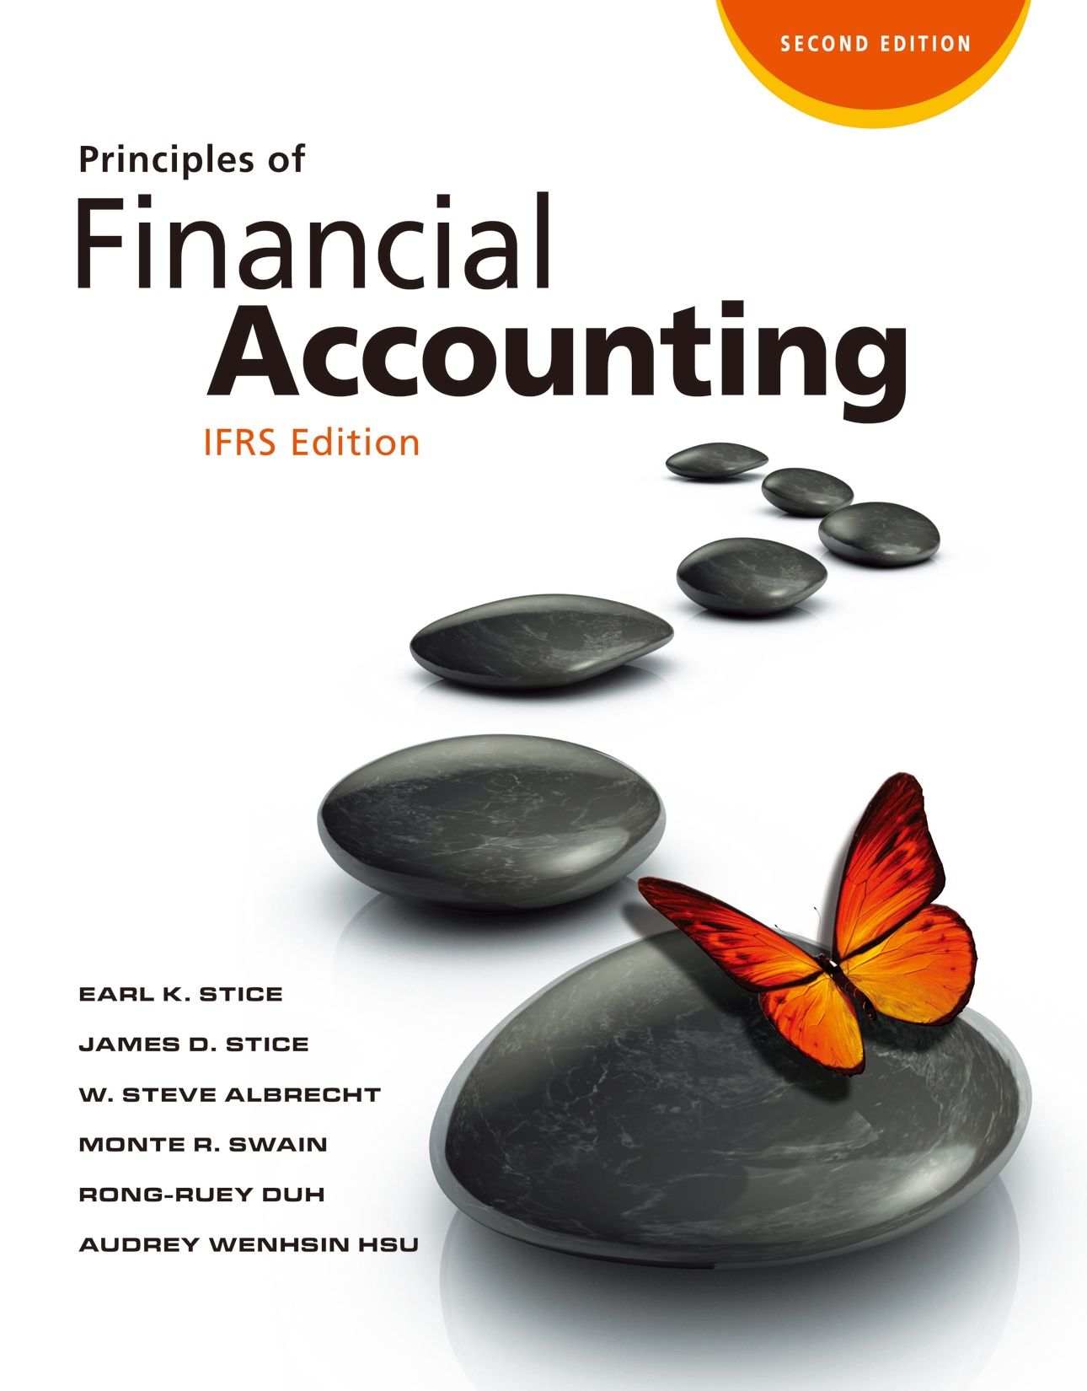

Slide 2
Analyzing Financial Statements

Slide 3
Financial Statement Analysis
The Need for Financial Statement Analysis
LO1
Involves the examination of both the relationships among financial statement numbers and the trends in those numbers over time.
Financial Ratios: Relationships between financial statement amounts.

Slide 4
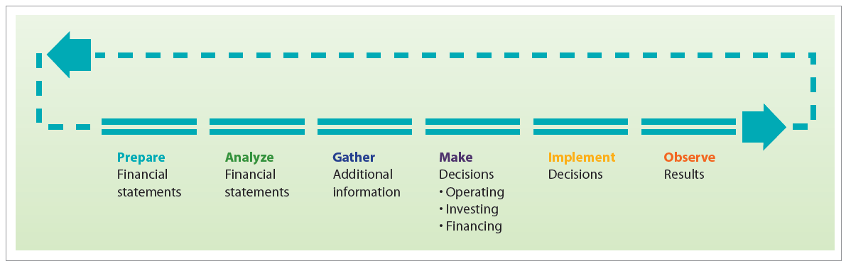
Financial Statement Analysis
LO1
Why Uses Financial Statement Analysis?
Exhibit 14.2

Slide 5
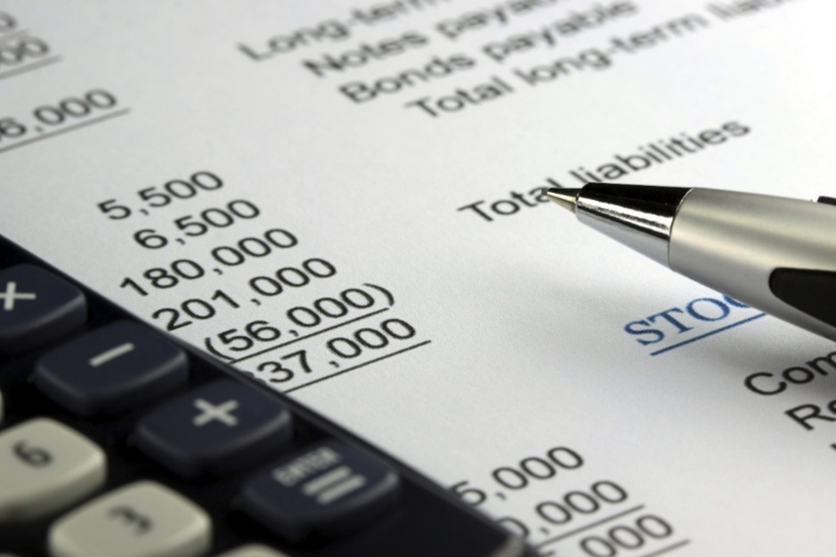
Financial Statement Analysis
LO1
Who Uses Financial Statement Analysis?
Investors
Creditors
Management

Slide 6
Vertical Analysis
Vertical and Horizontal Analyses
LO2
Also called common-size financial statements.
Show all amounts for a given period as a percentage of sales for that period in the case of a common-size statement of comprehensive income.
Show all amounts for a given period as a percentage of total assets for that period in the case of a common-size balance sheet.

Slide 7
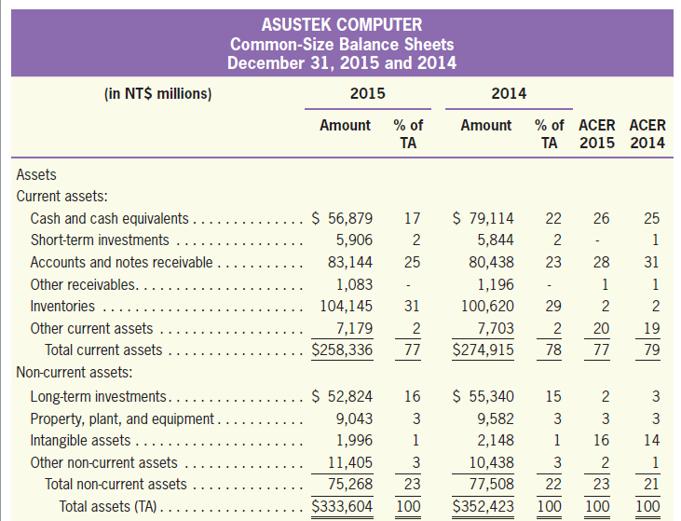
Vertical Analysis
LO2
Common-Size Balance Sheets for ASUS
Analysis Across Periods
Exhibit 14.3

Slide 8
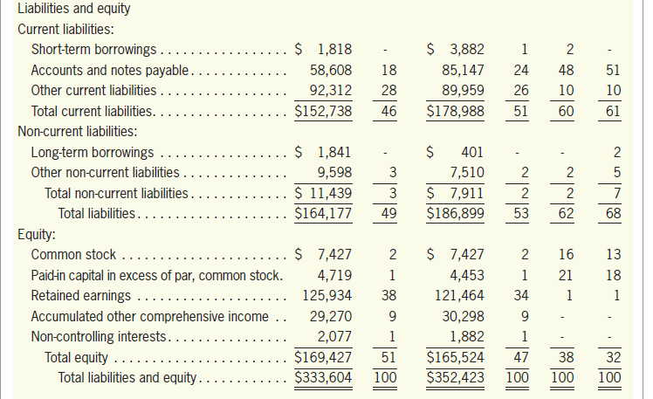
Vertical Analysis
LO2
Common-Size Balance Sheets for ASUS
Analysis Across Companies
Exhibit 14.3

Slide 9
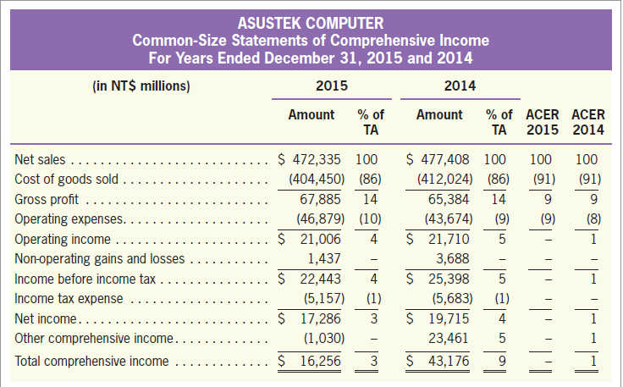
Vertical Analysis
LO2
Common-Size Statements of Comprehensive Income for ASUS
Exhibit 14.4

Slide 10
Horizontal Analysis
LO2
Help to capture the trend of the financial data of a company.
Percentage of Change
Current period amount － Base period amount
=
×
100%
Base period amount
Current period amount
Trend percent
=
×
100%
Base period amount

Slide 11
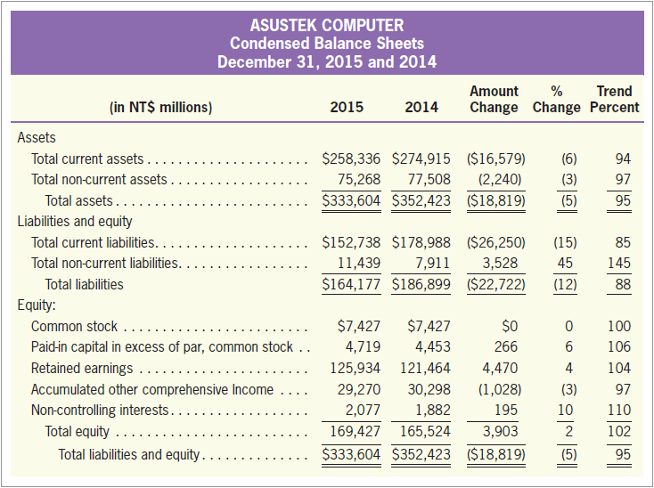
Horizontal Analysis
LO2
Exhibit 14.5

Slide 12
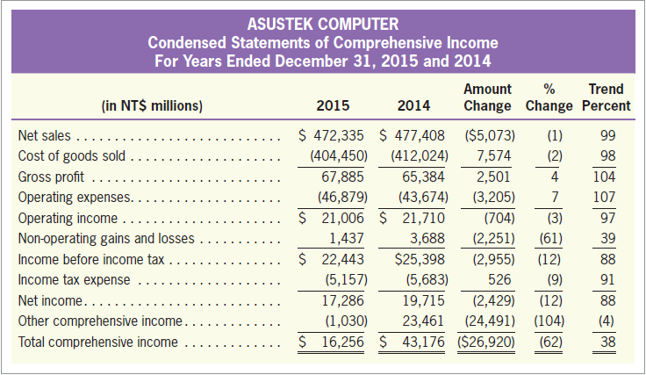
Horizontal Analysis
LO2
Exhibit 14.6

Slide 13
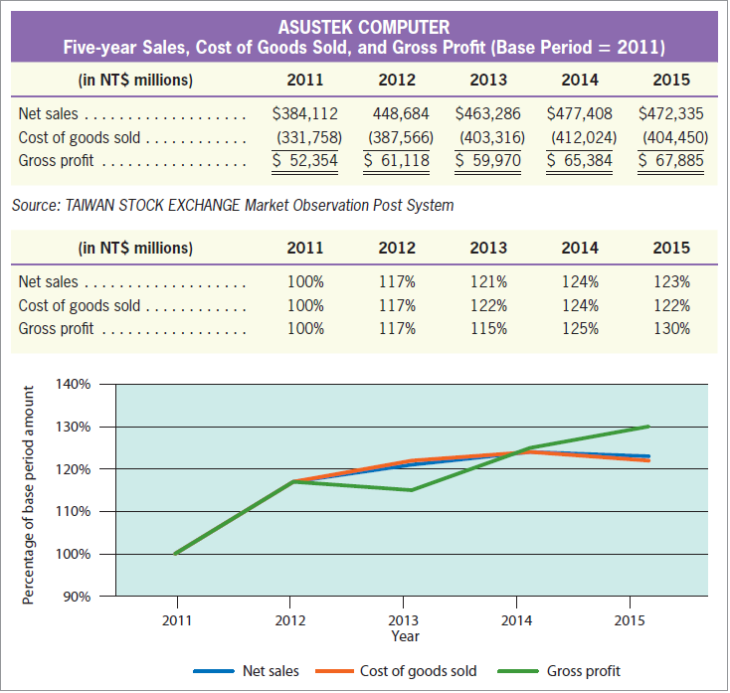
Horizontal Analysis
LO2
Exhibit 14.7

Slide 14
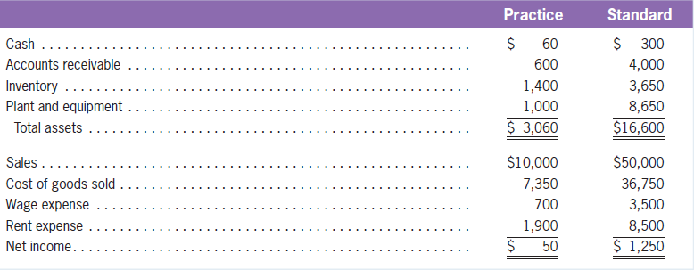
Quiz Yourself
LO2
The numbers below are for Practice Company and Standard Company. Standard is the industry benchmark.

Slide 15
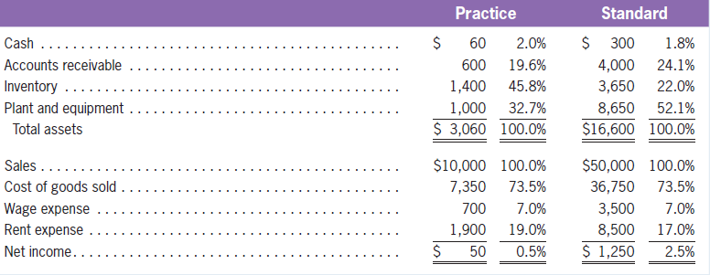
Quiz Yourself
LO2
Using common-size financial statements, analyze and compare the asset mix of Practice and Standard and identify which expense is causing Practice’s low profitability.
Solution

Slide 16
Liquidity and Efficiency
Financial Ratios
LO3
Liquidity
A company’s ability to pay its debts in the short run.
Efficiency
How successfully a company uses its assets.

Slide 17
Liquidity and Efficiency
LO3
Current Ratio
A measure of the liquidity of a business.
Current assets
Current Ratio
=
Current liabilities

Slide 18
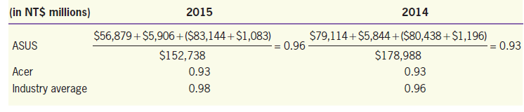
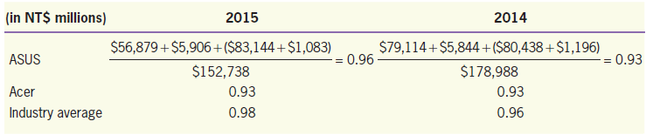
Liquidity and Efficiency
LO3
Acid-Test (Quick) Ratio
A measure of the immediate short-term liquidity of a business.
Cash + Short-term investments + Receivables (net)
Acid-test (quick) ratio
=
Current liabilities

Slide 19
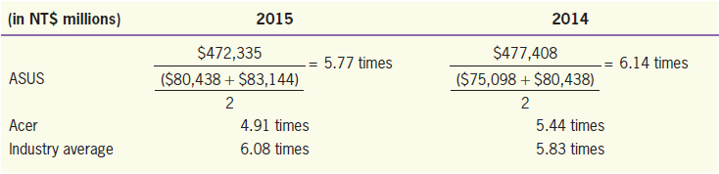
Liquidity and Efficiency
LO3
Accounts Receivable Turnover
A measure used to indicate how fast a company collects its receivables.
=
Net sales
Accounts receivable turnover
Average accounts receivable

Slide 20
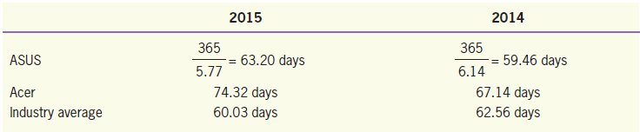
Liquidity and Efficiency
LO3
Average Collection Period
Accounts receivable turnover can be converted into the number of days it takes to collect receivables.
365
Average collection period
=
Accounts receivable turnover

Slide 21
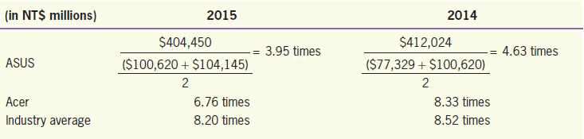
Liquidity and Efficiency
LO3
Inventory Turnover
A measure of the efficiency with which inventory is managed.
Cost of goods sold
Inventory turnover
=
Average inventory

Slide 22
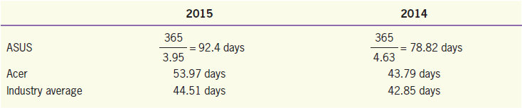
Liquidity and Efficiency
LO3
Number of Days’ Sales in Inventory
Inventory turnover can also be converted into the number of days’ sales in inventory.
Number of Days’ Sales in Inventory
365
=
Inventory turnover

Slide 23
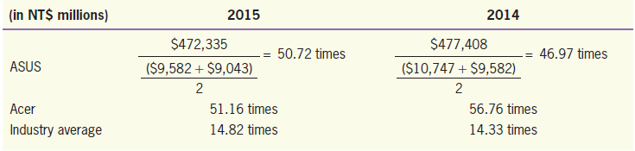
Liquidity and Efficiency
LO3
Fixed Asset Turnover (PP&E Turnover)
A measure of the number of dollars in sales generated by each dollar of fixed assets.
Net sales
Fixed asset (PP&E) turnover
=
Average fixed assets

Slide 24
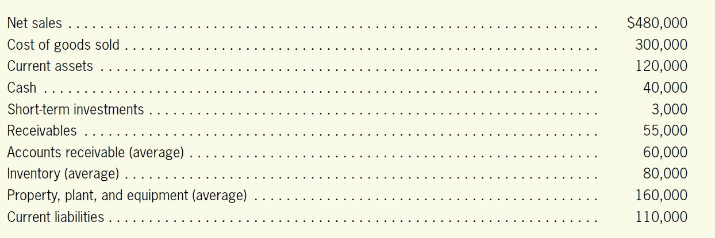
Quiz Yourself
LO3
The numbers below are for Shilo Falls Company.
Using these numbers, compute the following ratio values.

Slide 25
Quiz Yourself
LO3
Solution
Current ratio
Acid-test ratio
Accounts receivable turnover

Slide 26
Quiz Yourself
LO3
Solution
Average collection period
Inventory turnover

Slide 27
Quiz Yourself
LO3
Solution
Number of days’ sales in inventory
Fixed asset turnover

Slide 28
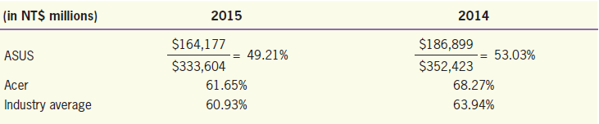
Solvency
LO3
A company’s ability to survive for a long period of time.
Debt Ratio
Total liabilities
Debt Ratio
=
Total assets

Slide 29
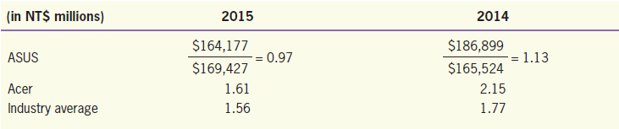
Solvency
LO3
Debt-to-Equity Ratio
A measure of the number of dollars of borrowed funds for every dollar invested by owners.
The ratio has a value of 1.0 if the amount of borrowing is exactly equal to the amount of stockholder investment.
Total liabilities
Debt-to-equity Ratio
Total liabilities
Debt-to-equity Ratio
=
=
Total equity
Total equity

Slide 30
Solvency
LO3
Difference between the Debt Ratio, the Debt-to-Equity Ratio, and the Assets-to-Equity Ratio
Debt-to-equity ratio: A ratio value of 1.00 means that total liabilities and total equity are equal.
Debt ratio: A ratio value of 1.00, or 100%, means that ALL of the company’s financing has come from debt and that there is no stockholder investment at all.
Assets-to-equity ratio: A ratio value of 1.00 means that total assets and total equity are equal to each other, implying that there are no liabilities.

Slide 31
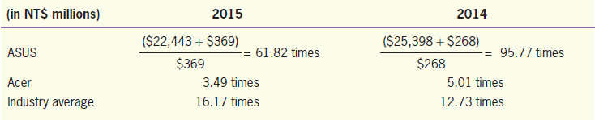
Solvency
LO3
Times Interest Earned Ratio
A measure of a borrower’s ability to make required interest payments.
Income before interest and taxes (operating profit)
Times interest earned
=
Annual interest expense

Slide 32
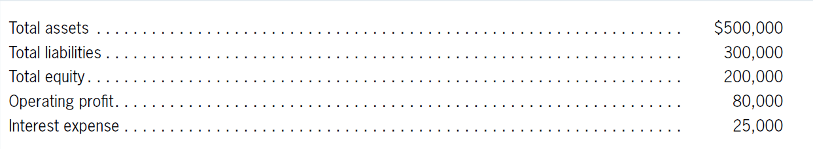
Quiz Yourself
LO3
The numbers below are for Hua Grill Company.
Using these numbers, compute the following ratio values.

Slide 33
Quiz Yourself
LO3
Solution
Debt-to-equity ratio
Debt ratio

Slide 34
Quiz Yourself
LO3
Solution
Assets-to-equity ratio
Times interest earned ratio

Slide 35
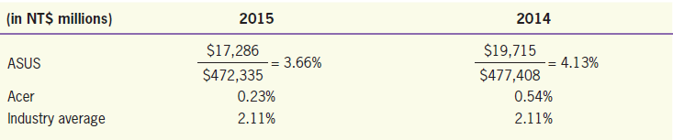
Profitability
LO3
A measure of a company’s operating success for a given period of time.
Profit Margin (Return on Sales)
A measure of the amount of profit earned per dollar of sales.
Profit margin (Return on sales)
Net income
=
Net sales

Slide 36
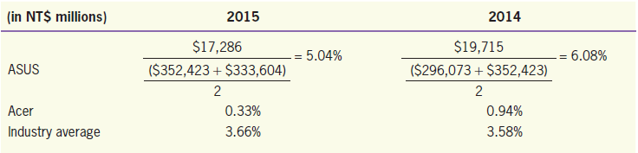
Profitability
LO3
Return on Assets
A measure of the company’s overall profitability of assets.
Return on assets
Net income
=
Average total assets

Slide 37
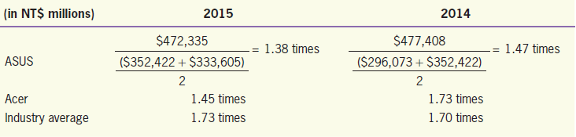
Profitability
LO3
Asset Turnover
A measure of company efficiency.
Asset turnover
Net sales
=
Average total assets

Slide 38
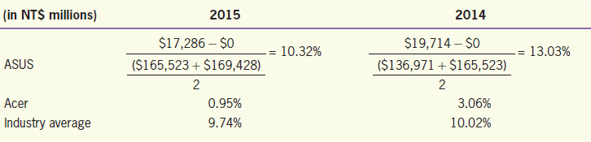
Profitability
LO3
Return on Equity
A measure of the amount of profit earned per dollar of investment.
Net income － Preference dividends
Return on equity
=
Average total equity

Slide 39
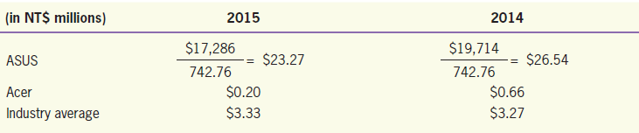
Profitability
LO3
Earnings Per Share (EPS)
A measure of the net income earned on each common share.
Net income － Preference dividends
Return on equity
=
Weighted-average common shares outstanding

Slide 40
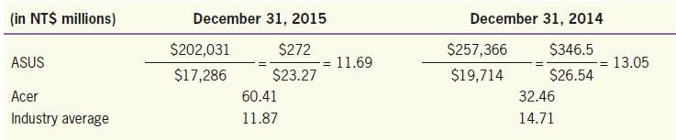
Profitability
LO3
Price-Earnings Ratio
A measure of growth potential, earnings stability, and management capabilities.
Market value of shares
Price per share
PE ratio
=
=
Net income
Earnings per share

Slide 41
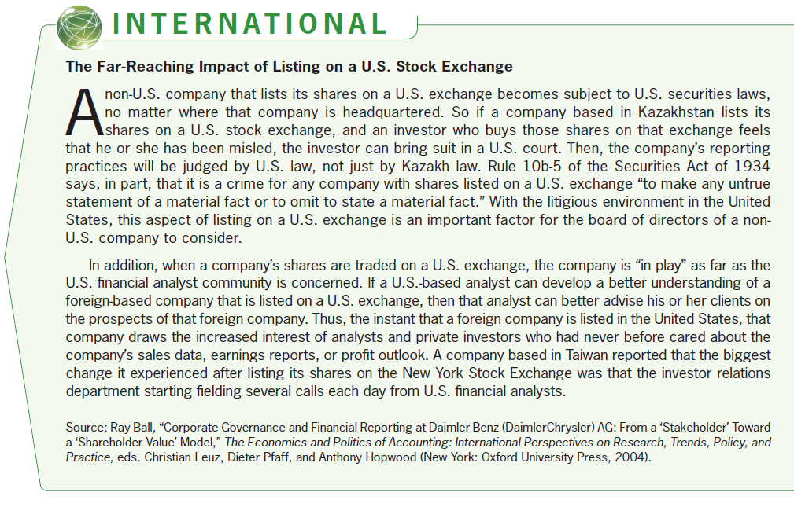
Profitability
LO3

Slide 42
Financial Ratio and the Relationship
LO3
The large majority of financial ratios, are either of the following:
A comparison of two amounts found in the same financial statements (ex: return on sales)
A comparison of two amounts from different financial statements (ex: asset turnover)

Slide 43
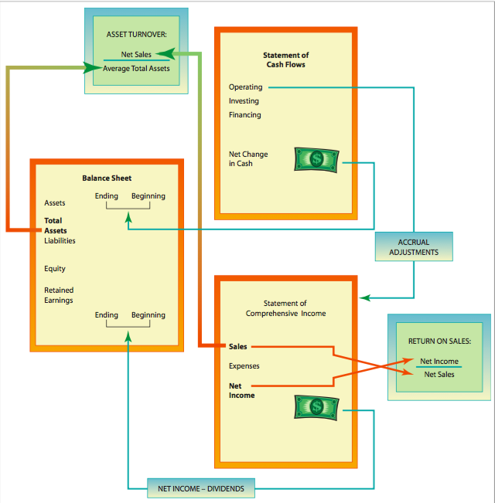
Financial Ratio and the Relationship
LO3
Exhibit 14.11

Slide 44
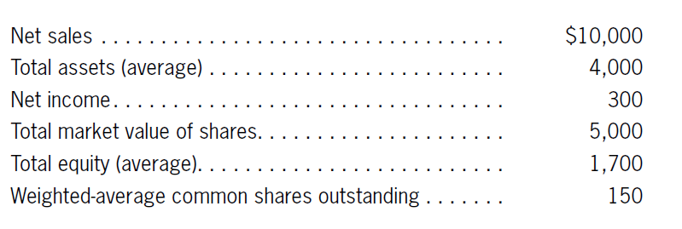
Quiz Yourself
LO3
The following numbers are from the financial statements of Optskametrist Company.
Using these numbers, compute the following ratio values.

Slide 45
Quiz Yourself
LO3
Solution
Profit margin
Return on assets
Asset turnover

Slide 46
Quiz Yourself
LO3
Solution
Return on equity
Earnings per share
Price-earnings ratio

Slide 47
Cash Flow
LO3
Usefulness of Cash Flow Ratios
Large Noncash Expenses
Rapid Growth
Window Dressing Time

Slide 48
Cash Flow
LO3
Cash Flow to Net Income
A ratio that reflects the extent to which accrual accounting assumptions and adjustments have been included in computing net income.
Cash Flow from Operations
Net Income

Slide 49
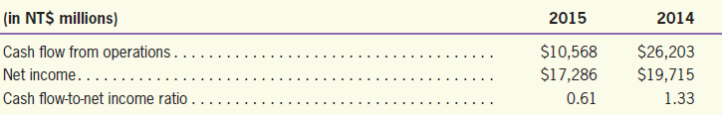

Cash Flow
LO3
Cash Flow to Net Income
For ASUS, computation of the cash flow-to-net income ratio is as follows:

Slide 50
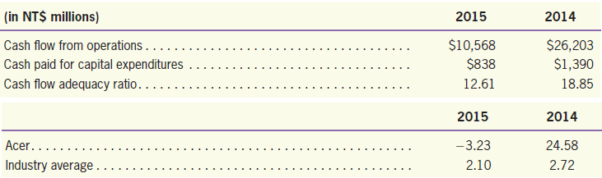
Cash Flow
LO3
Cash Flow Adequacy
Cash from operations divided by expenditures for fixed asset additions and acquisitions of new business.
Cash Flow from Operations
Cash Paid for Capital Expenditures

Slide 51
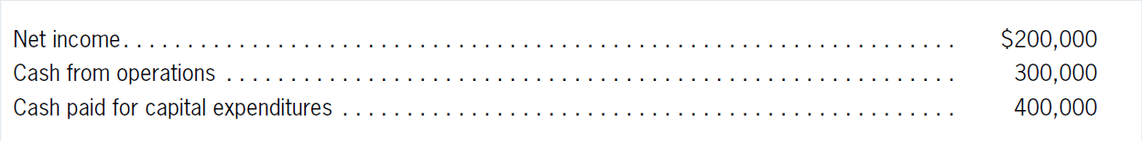
Quiz Yourself
LO3
The numbers below are for Club Zero Company.
Using these numbers, compute the following ratio values.

Slide 52
Quiz Yourself
LO3
Cash flow-to-net income ratio
Cash flow adequacy ratio

Slide 53
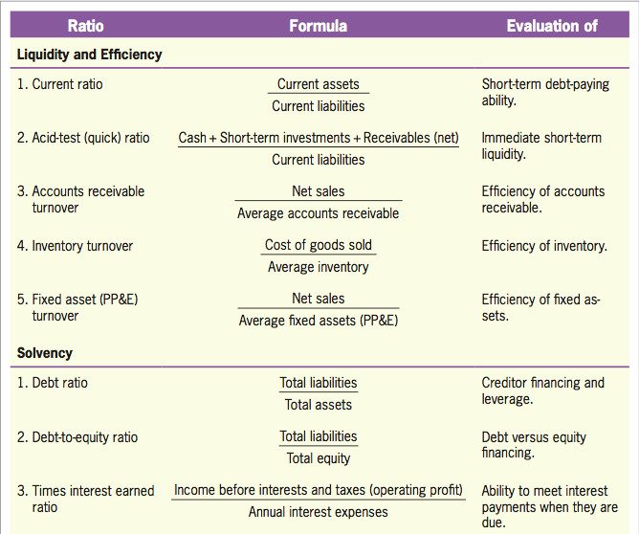
Summary of Ratios
LO3
Exhibit 14.13

Slide 54
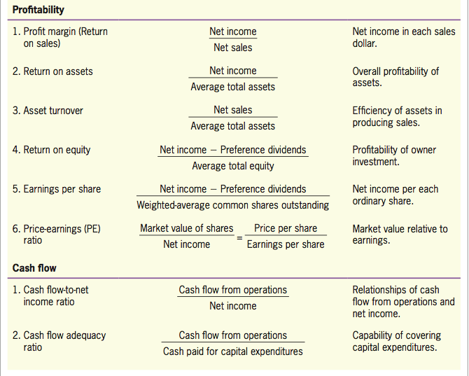
Summary of Ratios
LO3
Exhibit 14.13

Slide 55
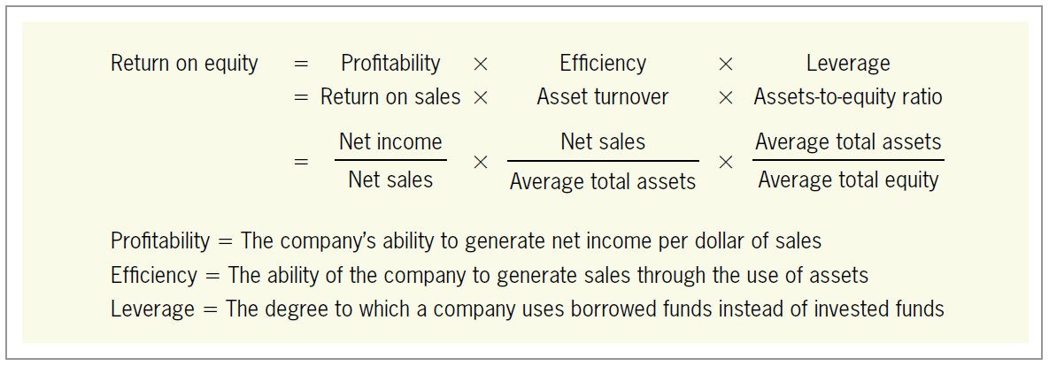
DuPont Framework
DuPont Framework
LO4
A systematic approach for breaking down return on equity to three ratios.
Exhibit 14.14

Slide 56
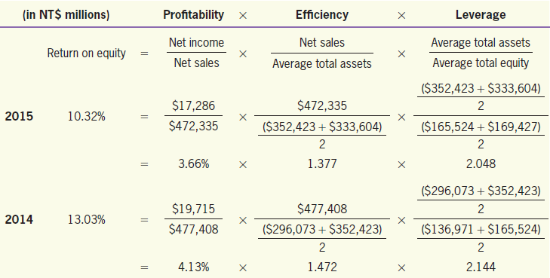
DuPont Framework
LO4
The DuPont analysis of ASUS’s ROE for 2014 and 2015 is as follow:

Slide 57
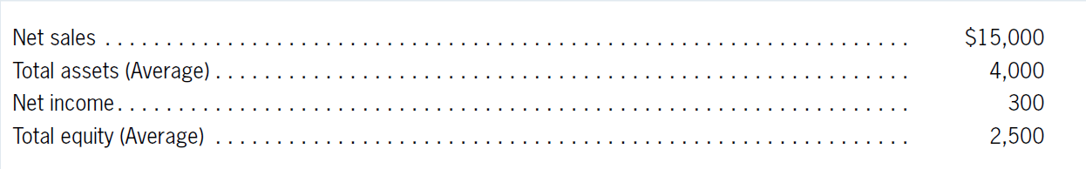
Quiz Yourself
LO4
The following numbers are from the financial statements of Shelley Company.
Using these numbers, compute the following DuPont framework ratio values.

Slide 58
Quiz Yourself
LO4
Solution
Return on equity
Return on sales

Slide 59
Quiz Yourself
LO4
Solution
Asset turnover
Assets-to-equity ratio

Slide 60
Potential Pitfalls
Potential Pitfalls
LO5
Financial Statements Don’t Contain All Information
Lack of Comparability
Search for the Smoking Gun
Anchoring, Adjustment, and Timeliness

